Slide 1
Advanced Geospatial Data Analytics: Pig and Python on Hadoop

Slide 2
Exploring radiation data into HDFS
Before you begin:
The data for the lab is stored in /gpfs_scratch/geog479/lecture7
Copy the data to your home directory:
cp -r /gpfs_scratch/geog479/lecture7 ~/

Slide 3
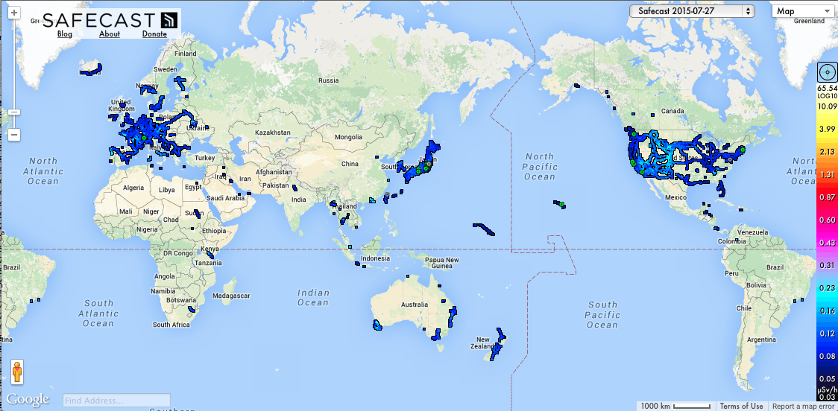
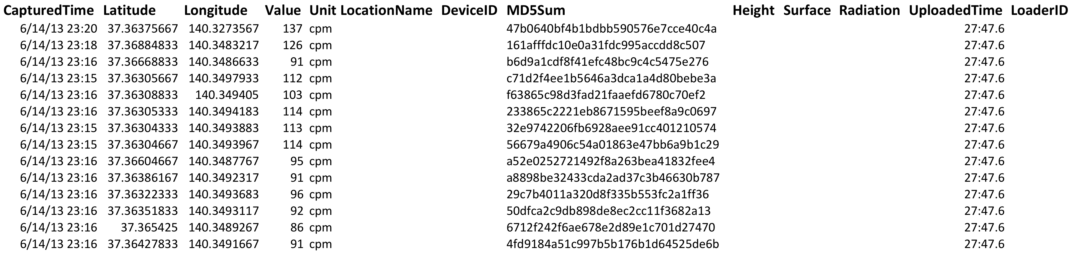
Data 1: Safecast dataset
Safecast -- http://blog.safecast.org

Slide 4
Case 1: Making a heatmap input data based on radiation dataset
Objective:
Use Pig to navigate through HDFS and explore a dataset.
Make a heatmap data for generating a heatmap image file.
Before you begin:
Radiation data is in ~/lecture7/data
Load the radiation data to HDFS
Optional: check the replication factor we had talked about
hdfs dfs -ls
hdfs dfs -setrep –w 2 radiation.csv
Now check the HDFS to see what happens
Notes:
hdfs dfs -copyFromLocal radiation.csv
hdfs dfs -setrep –w 3 -R /my/dir

Slide 5
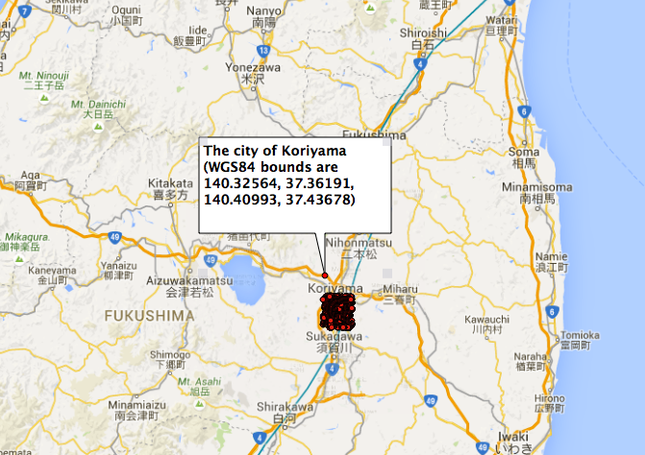

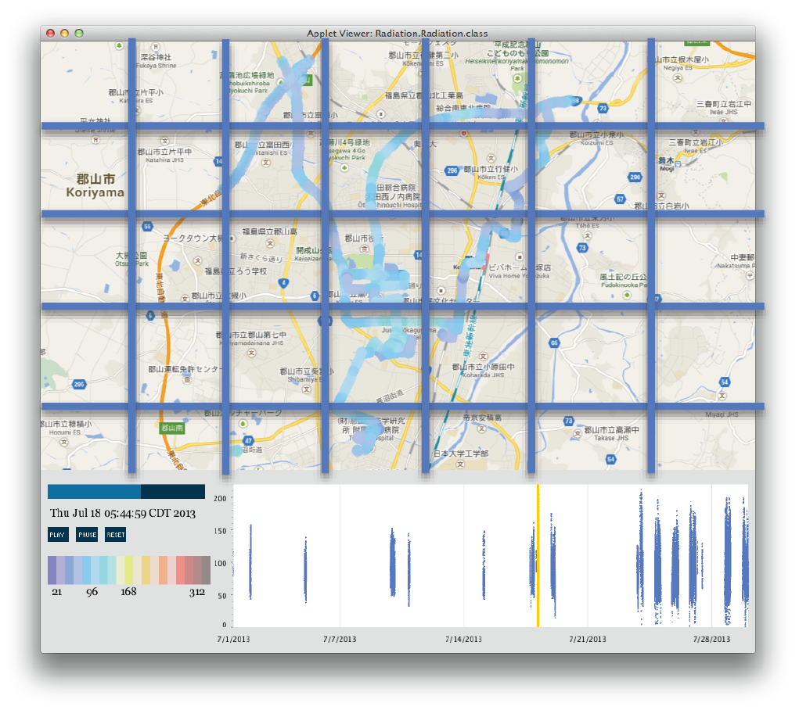
The city of Koriyama, Japan
((0,0), 120.97 cpm)
((0,1), 93.77 cpm)
((0,2), 108.32 cpm)
((0,3), 101.45 cpm)
((0,4), 112.87 cpm)
((0,5), 98.45 cpm)
((0,6), 119.32 cpm)
((0,7), 121.21 cpm)
…
Notes:
Putting a file into HDFS involves the following steps:

Slide 6
Step 1: Making a heatmap data
Start the Grunt Shell.
$ pig
Load the radiation.csv data in HDFS.
$ raw = LOAD 'radiation.csv' USING PigStorage(',') AS (CapturedTime : chararray,Latitude:double,Longitude:double,Value:int,Unit:chararray);
Step 1: Filter out CaptureTime.
$ step1 = FILTER raw BY CapturedTime is not null AND CapturedTime != 'null' AND CapturedTime != '';
Step 2: select the rows of which unit is cpm.
$ step2 = FILTER step1 BY $4 MATCHES 'cpm';
Step 3: Filter out the data based on the bounding box of Koriyama, Japan.
$ step3 = FILTER step2 BY $2 > 140.32564 AND $2 < 140.40993 AND $1 > 37.36191 AND $1 < 37.43678;

Slide 7
Step 1: Making a heatmap data
Step 4: Select the rows of which CapturedTime is August.
$ step4 = FILTER step3 BY ($0 > '2013-08-01 00:00:00' AND $0 < '2013-09-01 00:00:00');
Step 5: Generate new records to send down the pipeline to the next operator.
$ step5 = FOREACH step4 GENERATE $0,$1,$2,$3,$4;
Step 6: Generate new records based on latitude and longitude key.
$ step6 = FOREACH step5 GENERATE $3,(int)(($2 - 140.32564)/0.005) AS logkey,(int)(($1 - 37.36191)/0.005) AS latkey;
Step 7: Collect all records with the same latitude and longitude key.
$ step6_group = GROUP step6 BY (latkey,logkey);

Slide 8
Step 1: Making a heatmap data
Step 8: Calculate the average of radiation levels per each cell.
$ step6_avg = FOREACH step6_group GENERATE group, AVG(step6.Value);
Step 9: Sort data based on the group.
$ result = ORDER step6_avg BY group;
Step 10: Send the output to a folder in HDFS.
$ Store result into 'heatmap_output';
Step 11: Log out the Grunt shell
$ quit (or by Ctr + c )

Slide 9
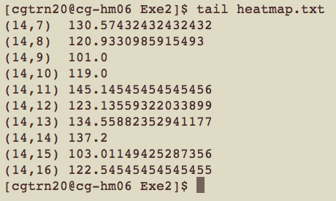
Step 2: Making a heatmap
Step 13: Take a source directory as input and concatenate files into the destination local file
$ hadoop fs -getmerge heatmap_output ~/lecture7/demo1/heatmap.txt
Check the content of heatmap.txt
$ tail heatmap.txt
python demo1.py

Slide 10
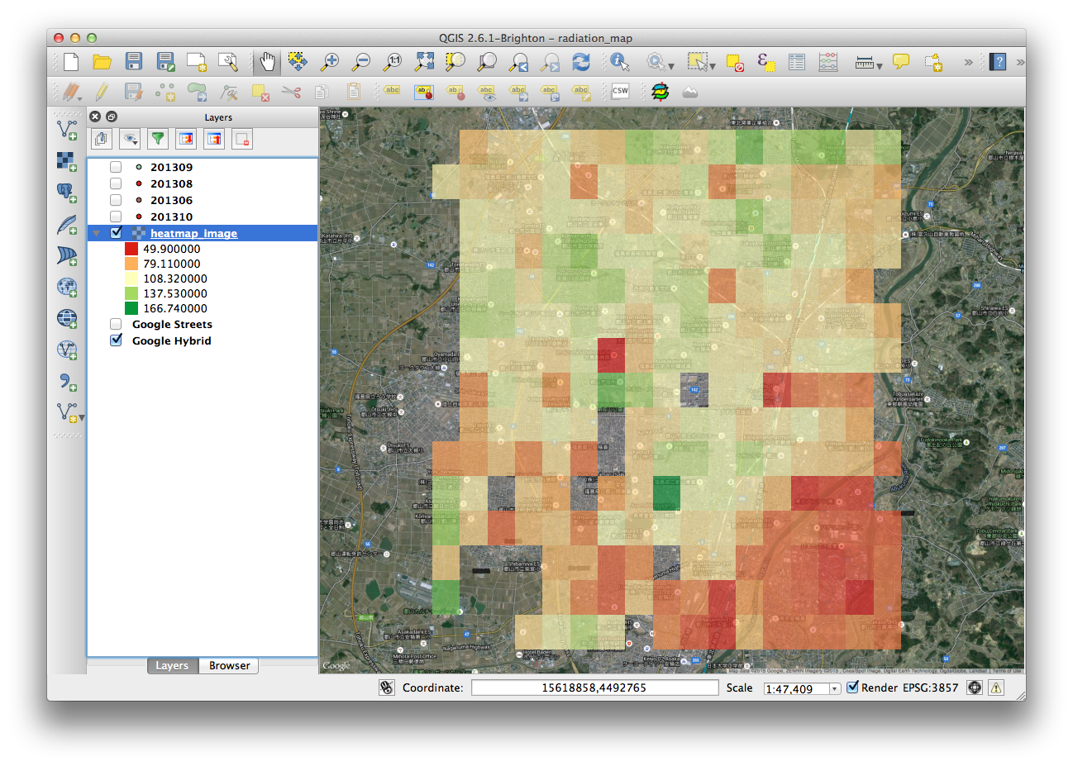
Visualize the generated heatmap
Notes:
For data exploration, jupyter/ipython or beaker are great. but for serious code that will be deployed, spyder, pycharm, etc.

Slide 11
Analyzing data with Pig UDF using Python
Notes:
Python is a programming language:
High level, Human readable, Interpreted, Highly extensible with a large collection of libraries variables.
We assume you are already familiar with Python. If not, it doesn’t matter, we will not implement Python codes. Just call Python code from Pig on Hadoop cluster.

Slide 12
Python in ROGER
There are multiple versions of Python installed in ROGER
List all the available Python environment in ROGER
In particular, the Python environment comes with Anaconda is used in this course
scipy, numpy, Pandas, Sciki-learn, gdal-python, etc.
IPython
IPython notebook

Slide 13
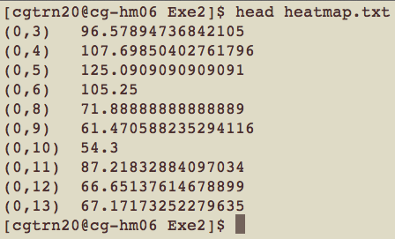
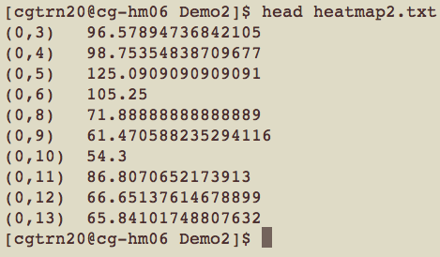
Case 2: Generating a heatmap after removing outliers using Pig UDF
Objective:
Make a heatmap image file (Ascii format) after removing outliers per each cell.
Compare the result with the one from the previous exercise.

Slide 14
Pig User Defined Functions (UDFs)
Alternatives to Hadoop streaming for running Python on a cluster
Pig User Defined Functions (UDFs): Invoking Python code from within a Pig script
Pig Streaming: Using the Pig STREAM command
Combine Pig’s operators with their own or others’ code via UDFs
Pig provides extensive support for user defined functions (UDFs) as a way to specify custom processing
Java
Jython: a Python implementation that runs on a JVM
Python (Python UDFs do not work on Hadoop 2.x)
Javascript, Ruby and Groovy (experimental)
Notes:
Hadoop streaming allows mappers and reducers to be written in any programming language.
you must translate your Python code using Jython into a Java jar file. Obviously, this is not very convenient and can even be problematic if you depend on Python features not provided by Jython

Slide 15
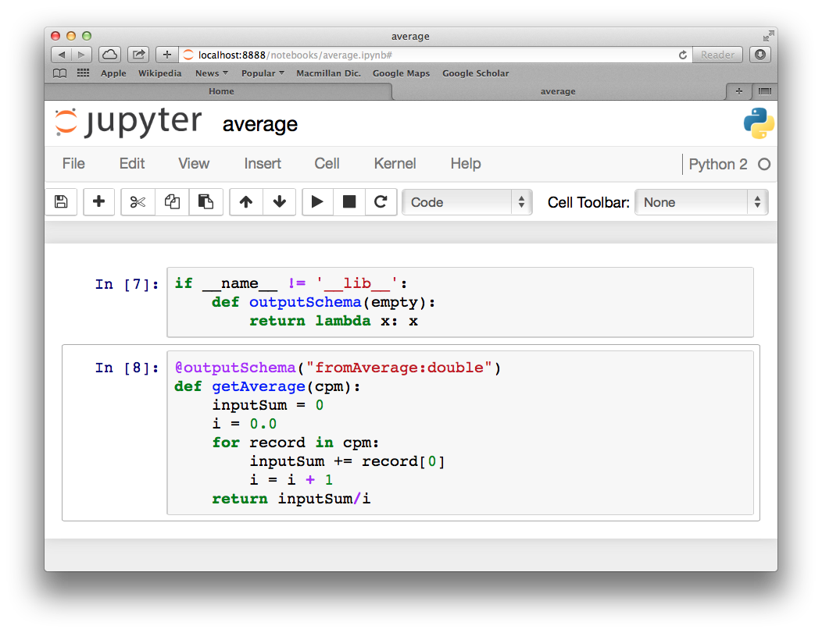
Writing a Pig UDF in Python
A UDF written in Python can be any Python function.
Annotate the function using @outputSchema so Pig can determine what the data type of the return value is.
Notes:
When developing UDFs
In Python,
you
need
to
include
the
@outputSchema
annotation,
which
causes
a
compiler
error
because
Python
tries
to
locate
the
outputSchema
function
and
it
is
not
something
that
can
be
imported.
(It
is
only
used
by
Pig.)
To
avoid
this
issue,
you
can
simply
define
outputSchema
to
be
a
no-°©‐op
function
in
your
Python
script
–
very
useful
for
development
and
testing:

Slide 16
Invoking a UDF
Before invoking a Python UDF, we need to register the text file that contains the function definition.
register 'udfs.py' using jython as udfs;
A = LOAD ‘work’ AS (department:chararray,name:chararray,salary:double);
B = GROUP A BY department;
C = FOREACH B GENERATE group, udfs.getAverage(A.Value) ;
By incorporating the UDF in the Pig script, we can take advantage of Pig’s ability to manipulate and group our big data, while also taking advantage of Python’s powerful but simple processing and logic.

Slide 17
Invoking a UDF
Work on the directory where you have the scripts ready
cd ~/lecture7/demo2
Run the pig script and see the results
What are the precedures?

Slide 18
Case 3: Implementing K-Means clustering on Hadoop for 311 Data
Objective:
Run a Pig script that streams data through a Python script.
Use Scikit-Learn to generate a K-Means clustering for 311 Data.
Before you begin:
You need to load module anaconda, which contains the k-mean clustering library you need
module load ?
Work on the directory where you have the scripts
cd ~/lecture7/demo3

Slide 19
Pig STREAM Command
The Pig STREAM command sends data to an external script or program. The syntax looks like:
alias = STREAM alias [, alias …] THROUGH {`command` | cmd_alias} [AS schema] ;
E.g., x = LOAD ’311_data';
result = STREAM x THROUGH `kmeans`;
Defining a streaming alias
Use the DEFINE command to assign an alias to a streaming command.
DEFINE kmeans `kmeans311.py` SHIP (‘kmeans311.py’)
Specify files that are needed on the worker nodes when using Pig streaming.
Notes:
It is important to understand how data is organized in the STREAM command, because your Python script is going to be distributed across the Hadoop cluster and only processing a subset of the input data.
Unordered data
Grouped data
Grouped and ordered data
No guarantee for the order in which the data is delivered to the streaming application.
The data for the same grouped key is guaranteed to be provided to the streaming application contiguously.
The data fro the same grouped key is guaranteed to be provided to the streaming application contiguously.
Additionally, the data within the group is guaranteed to be sorted by the provided secondary key.

Slide 20
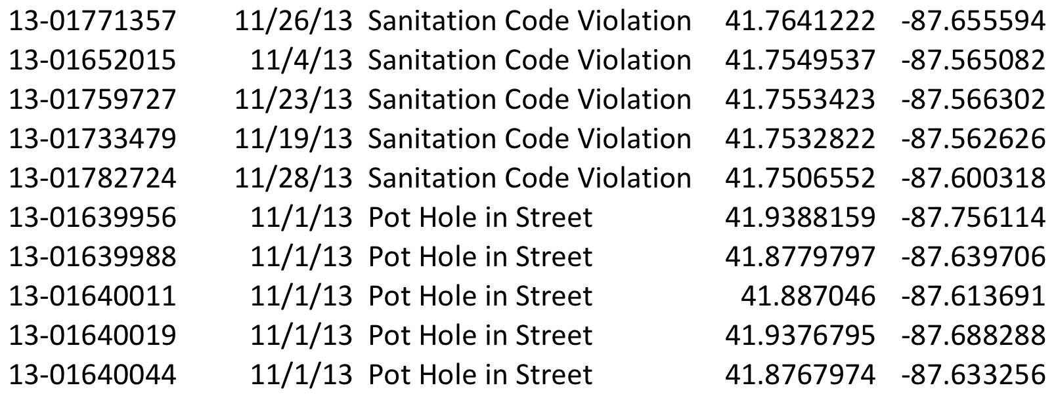
311 Dataset
311 is for non-emergency services.
Improved customer service for city departments and governmental agencies
Service requests:
Graffiti Removal, Vacant and Abandoned Buildings, Pot Holes, etc.
ID, Date, Request service, Latitude, Longitude
311 City Services – http://www.cityofchicago.org/city/en/depts/311.html
Notes:
311 is a telephone number for non-emergency services.
The aim of this service is to assist city departments and governmental agencies deliver improved customer service

Slide 21
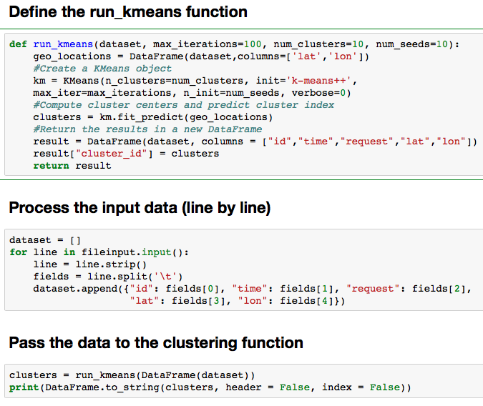
Python code to implement the K-Means clustering algorithm

Slide 22
Stream the data through a clustering algorithm using Pig streaming
define kmeans311 `/sw/anaconda/bin/python kmeans311.py` ship ('kmeans311.py');
raw = LOAD ’cybergis/311_data.csv' USING PigStorage(',') AS (id:chararray,time:chararray,request:chararray,Lat:double,Lon:double);
step0 = FILTER raw BY time != 'null' AND time != '';
step1 = FILTER step0 BY $0 is not null;
step2 = FILTER step1 BY $1 is not null;
step3 = FILTER step2 BY $2 is not null and $2 MATCHES 'Alley Light Out’;
step4 = FOREACH step3 GENERATE $0,$1,$2,$3,$4;
result = stream step4 through kmeans311;
store result into 'kmeans_output';

Slide 23
K-Means Clustering
Step 1: Put the data in HDFS
$hdfs dfs -copyFromLocal 311_data.csv
Step 2: Run the Pig Script
$pig kmeans311.pig
Save the result to the local directory
$hdfs dfs -getmerge kmeans_output kmeans.csv
Visualize the results as points in ArcGIS or QGIS
Take advantage of MobaXterm

Slide 24
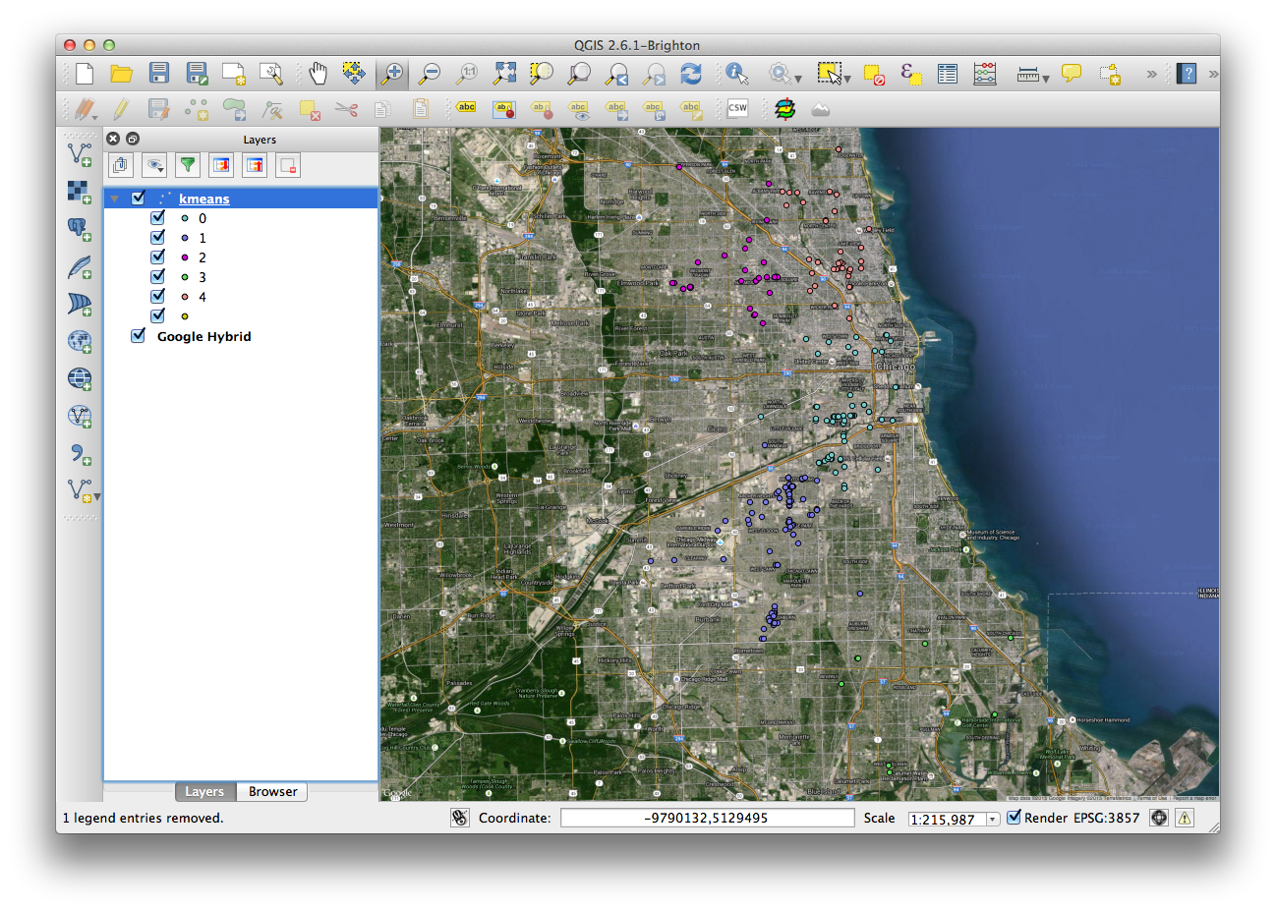
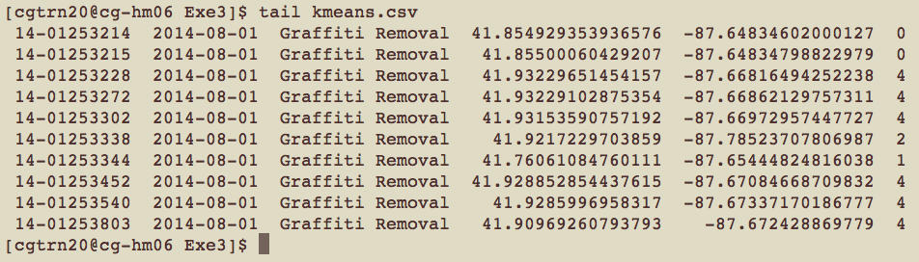
K-Means Clustering
Step 3: View the result
$tail kmeans.csv
K-Means clustering for Graffiti removal requests from 01/15/2015 to 08/01/2014.

